Slide 1


AP® Research Student Workbook Activity Slides 2015

Slide 2
Formative Assessment: Poster Presentation and Elevator Speech

Slide 3
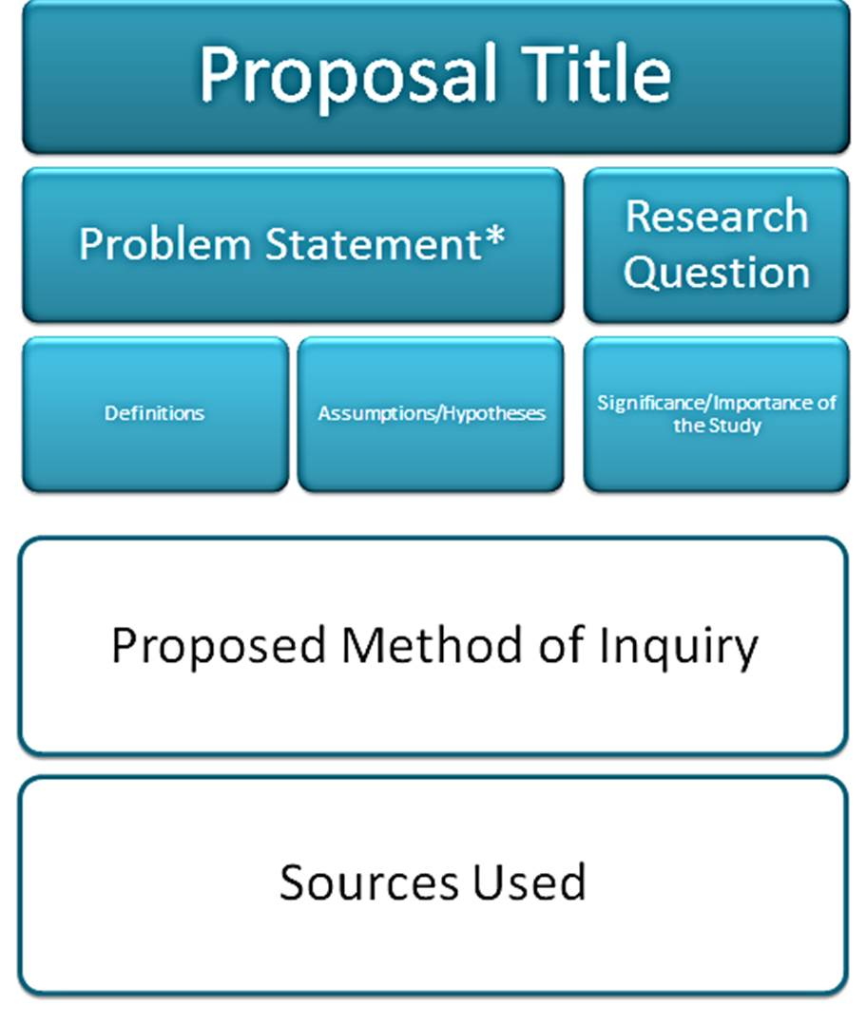
Poster Presentation (An Example)
Notes:
This format (or whatever format you choose) could be used throughout the year

Slide 4
Add to the Poster throughout the Year
Proposal Title
Problem Statement
Research Question
Definitions
Assumptions
Hypotheses
Significance/
Value of Study
Proposed Method of Inquiry

Slide 5
Add to the Poster throughout the Year
Results/Findings
Implications
Next Steps
Most Important Sources

Slide 6
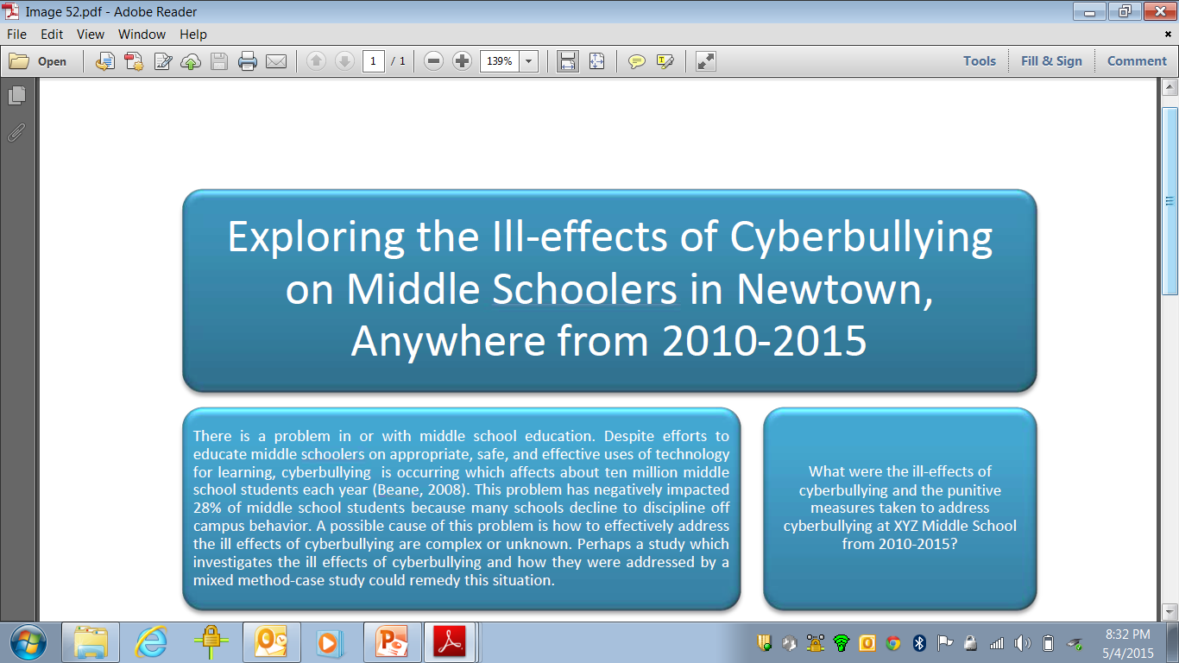
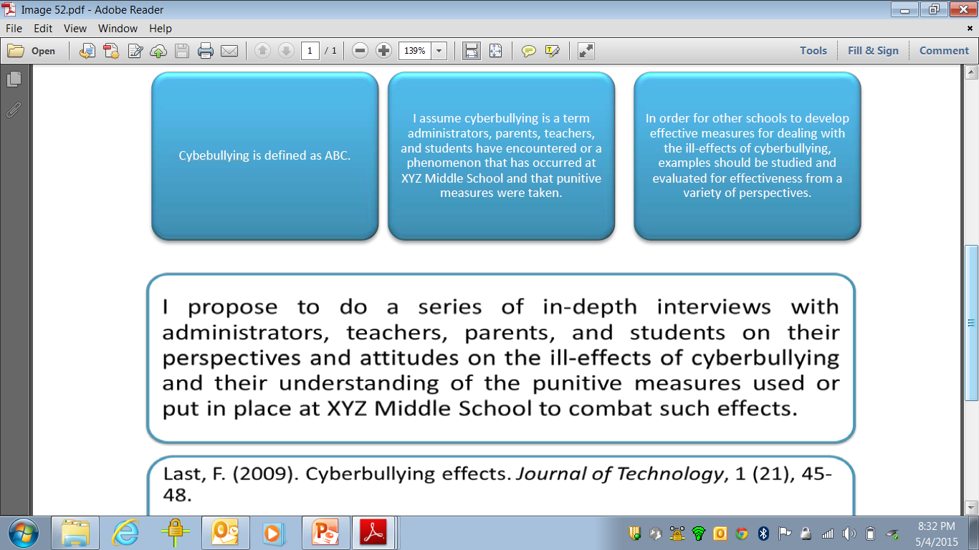

Slide 7
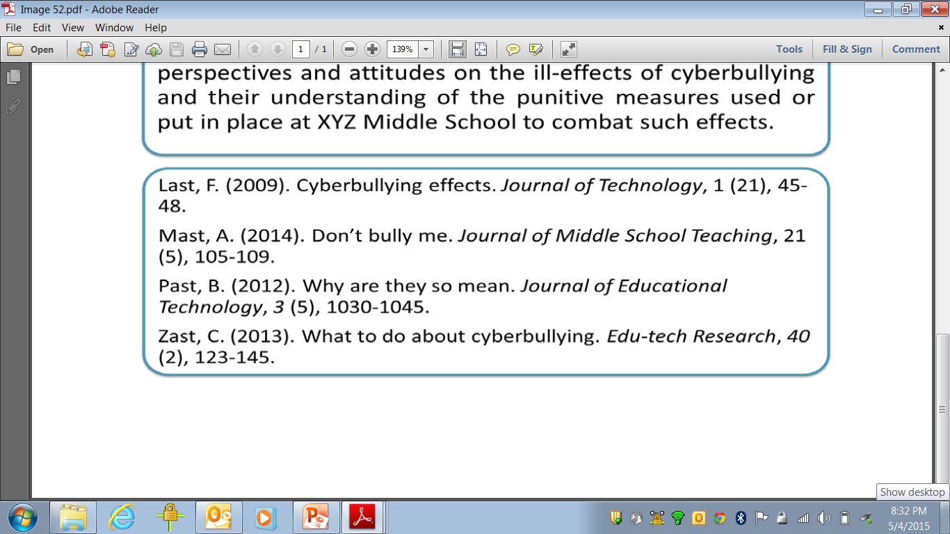
Notes:
Posters are nice to have for open house-to print out-and kids can add to it as they go throughout the year. At Fall Open House- if students get questions from parents-they realize they need to revise or have more work to do.

Slide 8
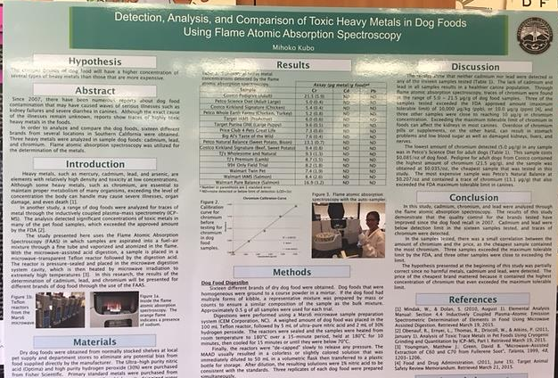
Great Source for Templates
http://www.makesigns.com/SciPosters_Templates.aspx

Slide 9
The Elevator Speech
Imagine that you step into an elevator and find your teacher, who asks, “So, how’s your research going? What do you expect to say?” You have only a couple of floors to sum up where you are. Early on, you can use this plan:
1. I am working on the problem of [state your question].
2. I think I can show that [state your hypothesis] because [state your reasons].
3. My best evidence is [summarize your evidence].
As you learn more and your argument develops, refine your elevator story and tell it again. The more you summarize your argument in an elevator story, the sooner your paper will come together.

Slide 10
Example Elevator Speech
I am working on the problem of understanding the ill effects of cyberbullying on middle school girls and the appropriate punitive actions for schools to take to protect students against and from using cyberbullying tactics.
I think I can show that some of the ill effects of cyberbullying are ABC and that the appropriate punitive actions taken by School ABC are 1,2,3, which showed a decrease in cyberbullying with middle school girls.
My best evidence is pertaining to the ill-effects of cyberbullying and middle school girls is the Beane, 2008 study which states RST. And the best evidence I have about effective punitive actions comes from the Made-up-name, 2015 article which states 1,2,3.

Slide 11
Activities 1-2: Developing Your Poster Proposal & Elevator Speech

Slide 12
Develop Your Poster
Transform your developed inquiry components thus far into a poster proposal, which should include components from the template that your teacher chooses.

Slide 13
Elevator Speech
Develop the components of your elevator speech using the workbook description as a guideline, and determine what elements of your poster you will emphasize in your speech. Be prepared to share your poster and speech with the class.
Work with your teacher to determine the criteria for peer-evaluating the presentations of your classmates.
Upon presenting and reviewing one another’s’ work, reflect on the feedback you received and make a decision (with rationale) to either make revisions or to keep your work as is.

